Slide 1
Computer Systems & Low-Level Programming
Basics of Systems and C
Marija Stanojevic
Spring 2019

Slide 2
Review
What does typed language mean? Is C typed language?
You need to define type of variable (int, float, double, char). C is typed language
Why is C important/used today?
It’s fast and tiny. It is part of OS, microchip prog., IoT, embedded and real-time systems.
What is compiler doing? What is linker doing?
Compiler translates from C into assembler. Linker links assembler code from different files.
What is syntax error (compile-time error)? Examples?
Compiler can’t recognize statement because it violates language rules (e.g. forgotten ;)
What is run-time error? Examples?
Runned program is in forbidden position or doing undefined operation (e.g. division with 0)
What is assembly language? How does it differ from C?
Lower level than C. Each word of assembler translates into 0s and 1s.
What is interpreter? Which languages are interpreted?
Interpreter executes high-level languages. Much slower than compiler. More on next slide.

Slide 3
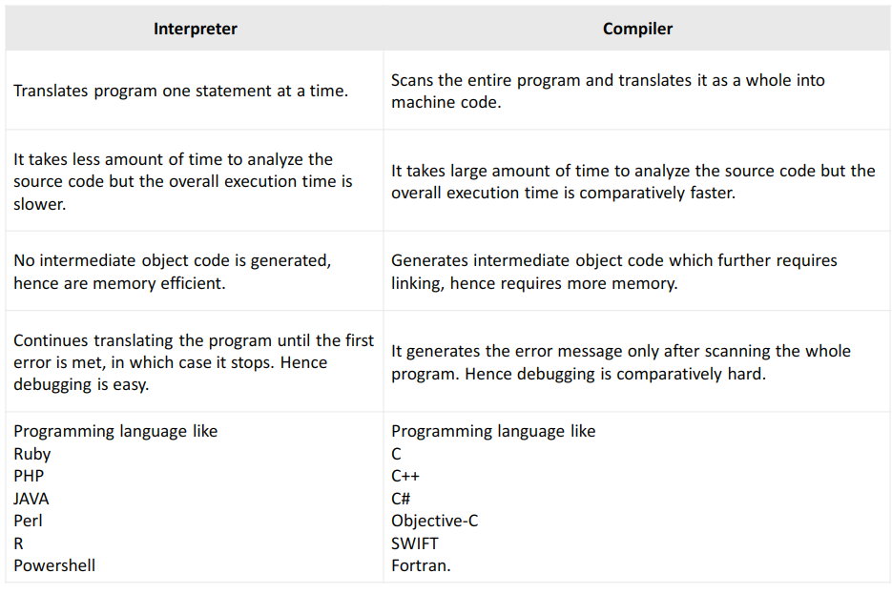

Slide 4
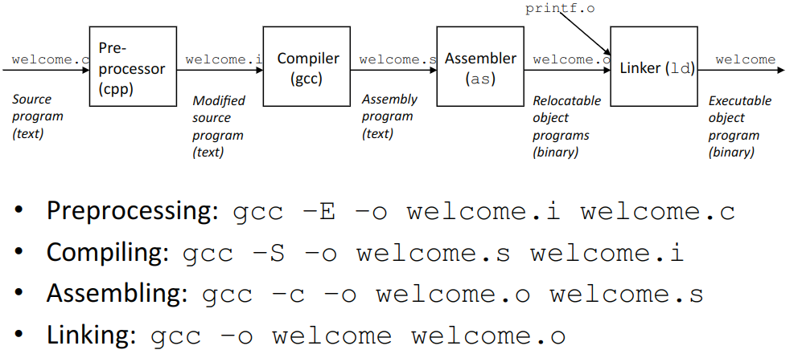

Slide 5
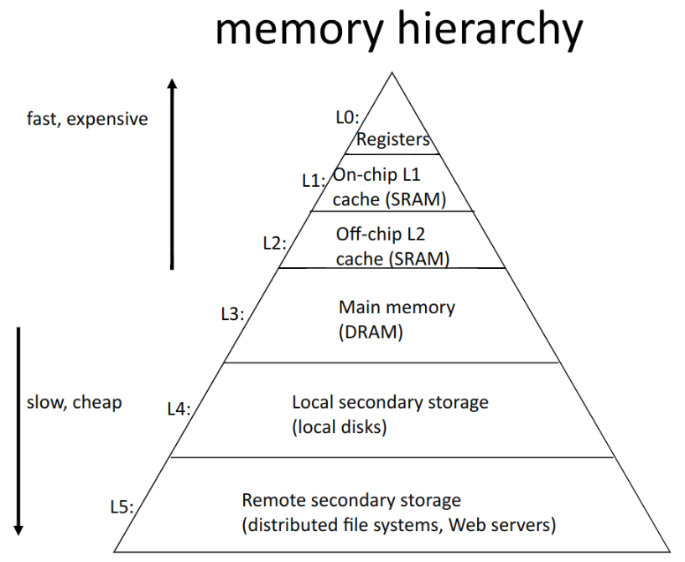

Slide 6
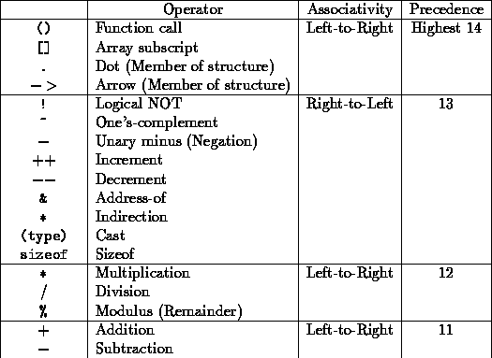
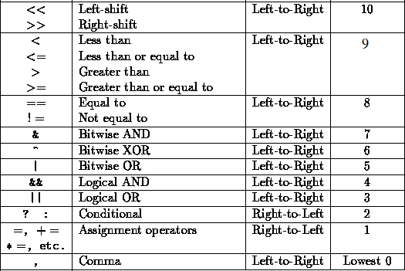
Operators in C

Slide 7
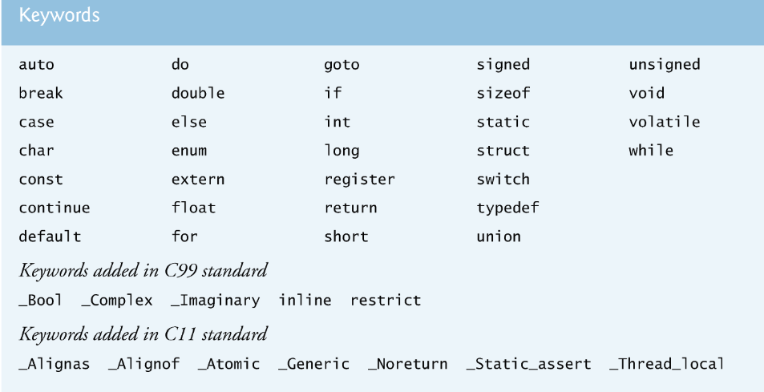

Slide 8
Data types
char, 1B, numbers between -128 and 127 (signed char) - ASCII table
unsigned - just positive numbers (add in front of any whole number data type)
unsigned char, 1B, numbers between 0 and 255
short, 2B, numbers between -32,768 and +32,767
int, 4B, -2,147,483,648 to +2,147,483,647
long, 4B, -2,147,483,648 to +2,147,483,647
float, decimal numbers with 4B
double, decimal numbers with 8B
long double, decimal numbers with 10B
void - for functions that don’t return anything, address when type is not known
int *, short*, double*, char* to represent address of certain type

Slide 9
Code from Lab 2
// part 2 of file
scanf("%d", &age);
printf("What is your avg. grade?");
scanf("%f", &grade);
if (age > 0) {
printf("Age is correct! \n");
} else {
printf("Error! You didn't write correct age\n");
age = 0;
}
printf("Your age is %d. Your avg. grade is %.2f \n", age, grade);
for (int i=0; i < 16; i++) {
printf("Still too young to drive \n");
}
int vote = canIvote(age);
printf("Voting %d", vote);
return 0;
}
// hello.c, part 1
#include<stdio.h>
int canIvote(int age) {
if (age >= 21) {
return 1;
} else {
return 0;
}
}
int main() {
char name[50];
printf("Address %p", name);
int age;
float grade;
char exclamation = '!';
scanf("%s", name);
printf("Hello %s%c What's your age?\n", name, exclamation);

Slide 10
Lab 3 presentation

